Slide 1


Computer vision: models, learning and inference
Chapter 14
The pinhole camera

Slide 2
Structure
Pinhole camera model
Three geometric problems
Homogeneous coordinates
Solving the problems
Exterior orientation problem
Camera calibration
3D reconstruction
Applications
Computer vision: models, learning and inference. ©2011 Simon J.D. Prince
2

Slide 3
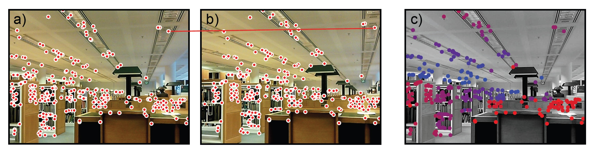
Motivation
Sparse stereo reconstruction
Compute the depth at a set of sparse matching points

Slide 4
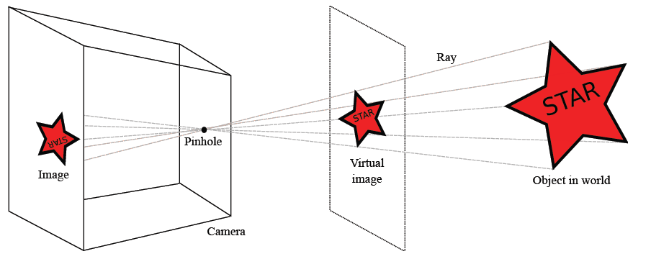
Pinhole camera
Real camera image
is inverted
Instead model impossible but more convenient virtual image

Slide 5
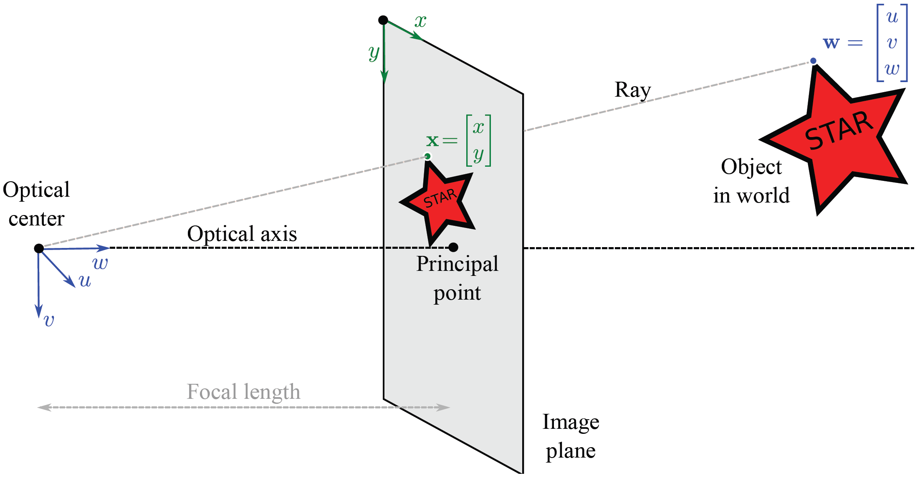

Pinhole camera terminology

Slide 6
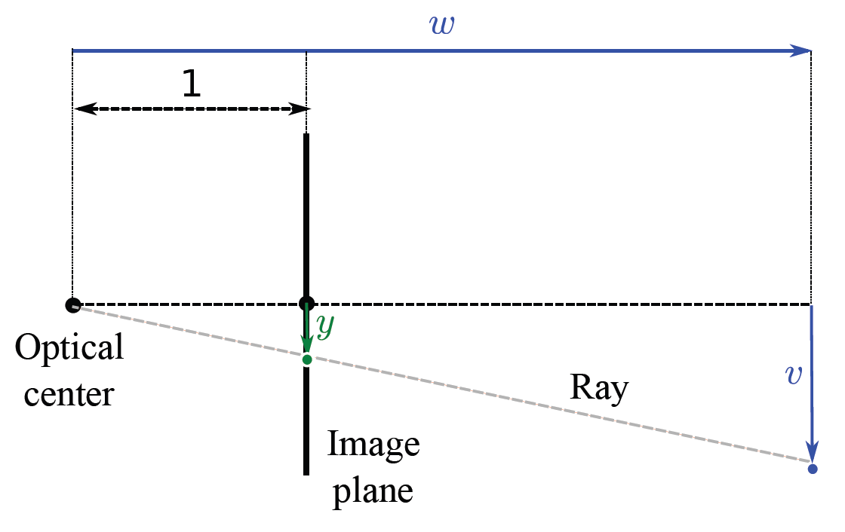
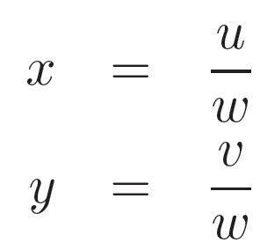
Normalized Camera
By similar triangles:

Slide 7
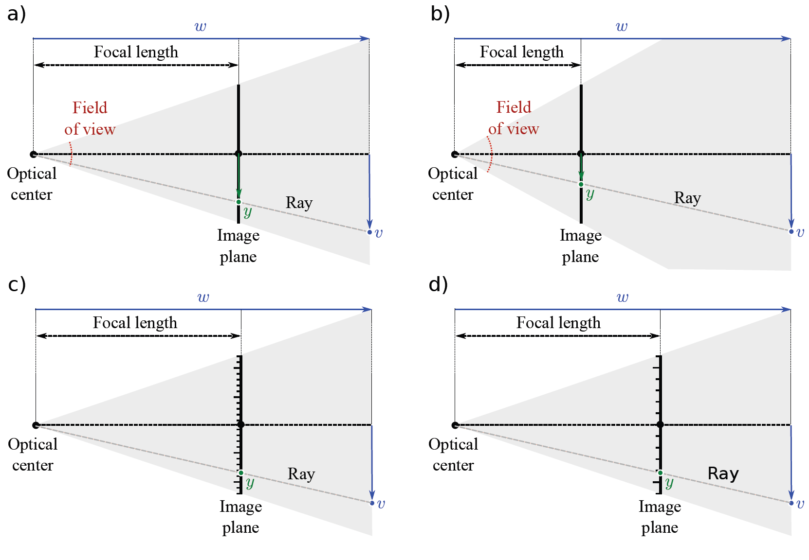



Focal length parameters

Slide 8
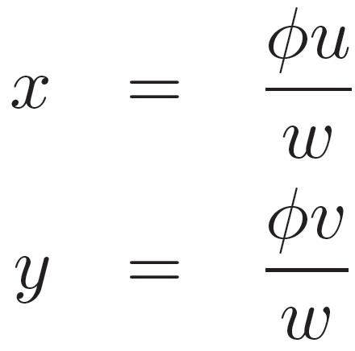
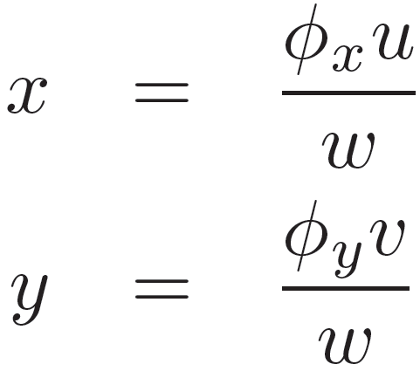















Focal length parameters
Can model both
the effect of the distance to the focal plane
the density of the receptors
with a single focal length parameter φ
In practice, the receptors may not be spaced evenly in 2D:
So use different focal length parameter for x and y dims

Slide 9
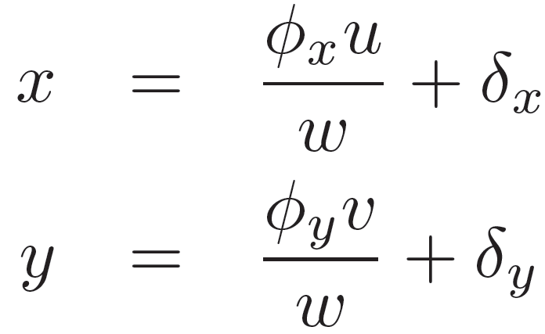


Offset parameters
Current model assumes that pixel (0,0) is where the principal ray strikes the image plane (i.e. the center)
Model offset to center

Slide 10
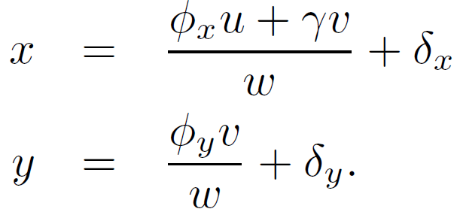
Skew parameter
Finally, add skew parameter
Accounts for image plane being not exactly perpendicular to the principal ray

Slide 11
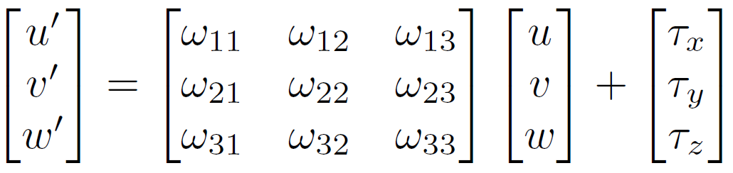
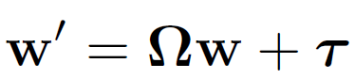




Position and orientation of camera
Position w=(u,v,w)^{T} of point in the world is generally not expressed in the frame of reference of the camera.
Transform using 3D transformation
or
Point in frame of reference of camera
Point in frame of reference of world

Slide 12
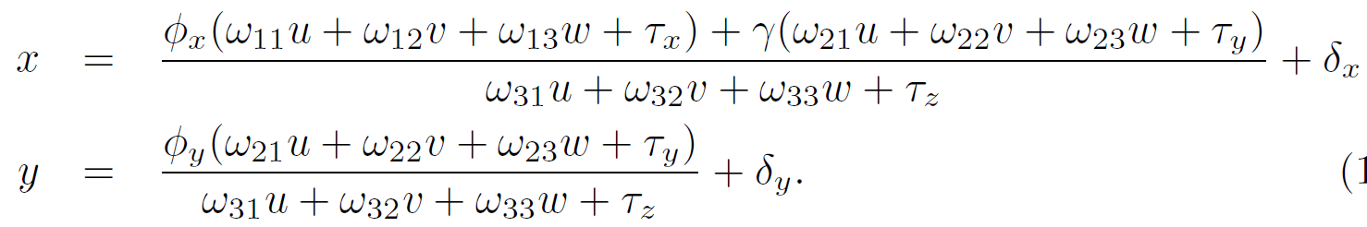
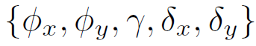
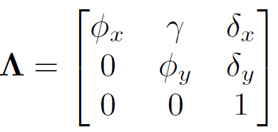
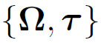

Complete pinhole camera model
Intrinsic parameters (stored as intrinsic matrix)
Extrinsic parameters

Slide 13
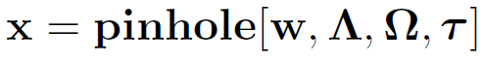






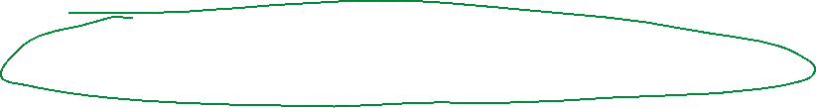

Complete pinhole camera model
For short:
Add noise – uncertainty in localizing feature in image
因为这里在加噪声
否则直接等于就可以了

Slide 14
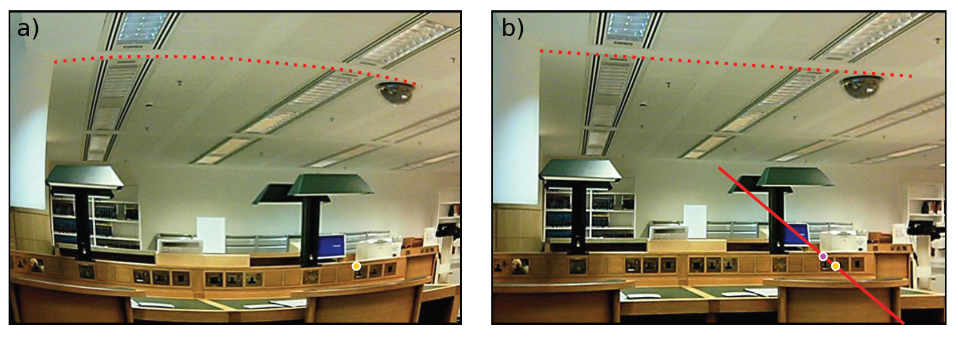
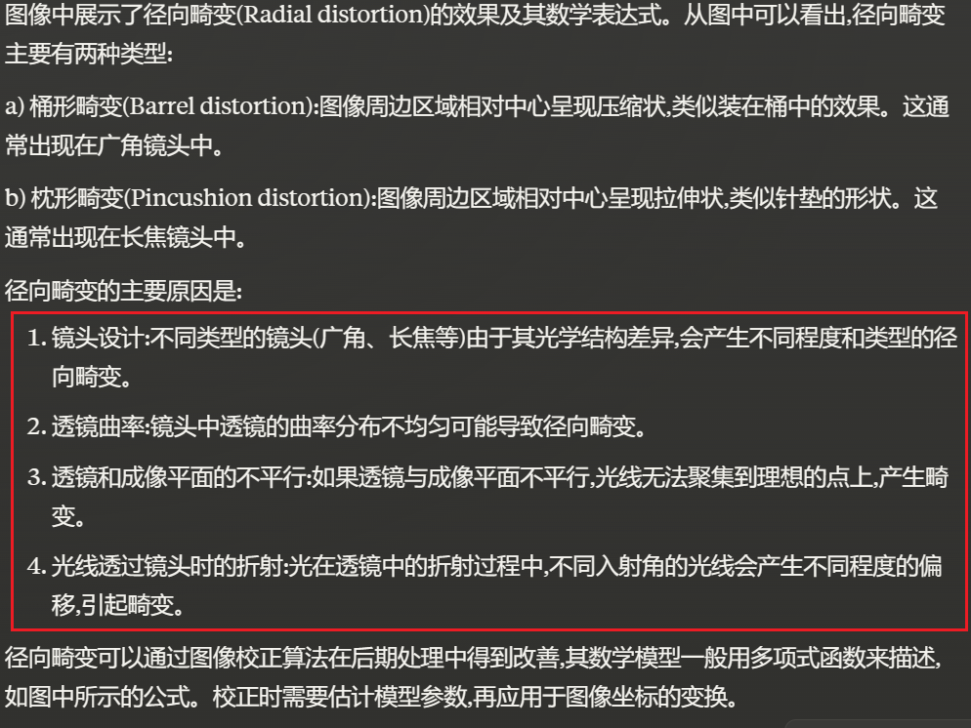
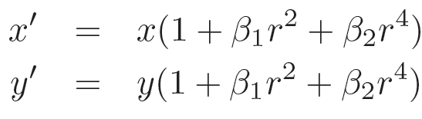



Radial distortion

Slide 15
Structure
Pinhole camera model
Three geometric problems
Homogeneous coordinates
Solving the problems
Exterior orientation problem
Camera calibration
3D reconstruction
Applications
Computer vision: models, learning and inference. ©2011 Simon J.D. Prince
15

Slide 16
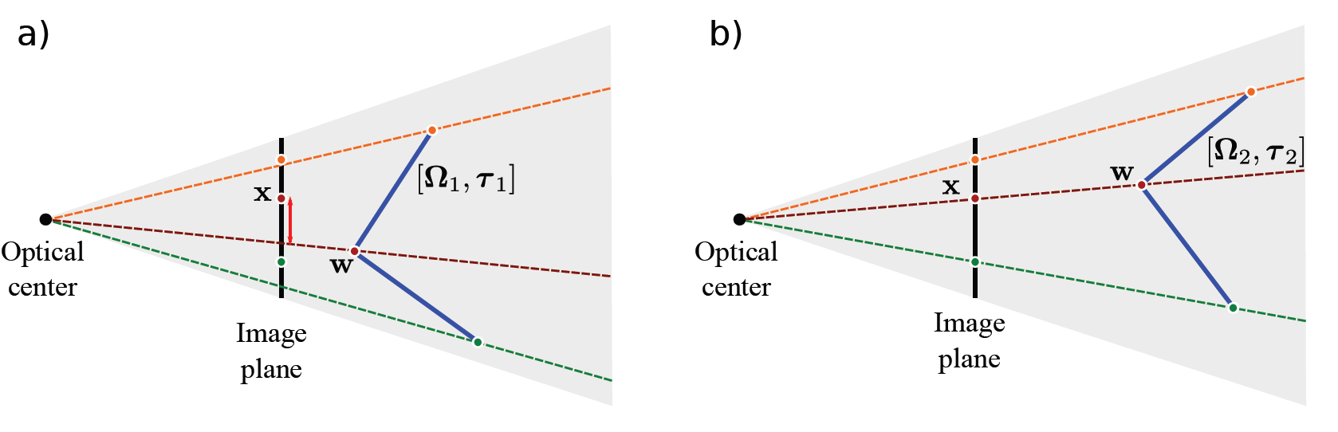
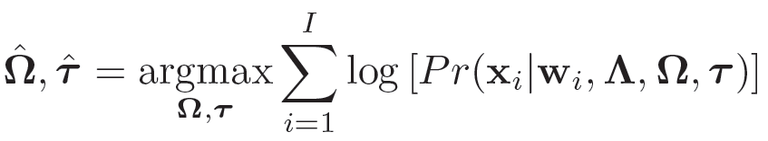

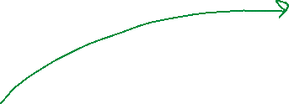



Problem 1: Learning extrinsic parameters (exterior orientation)
Use maximum likelihood:

Slide 17
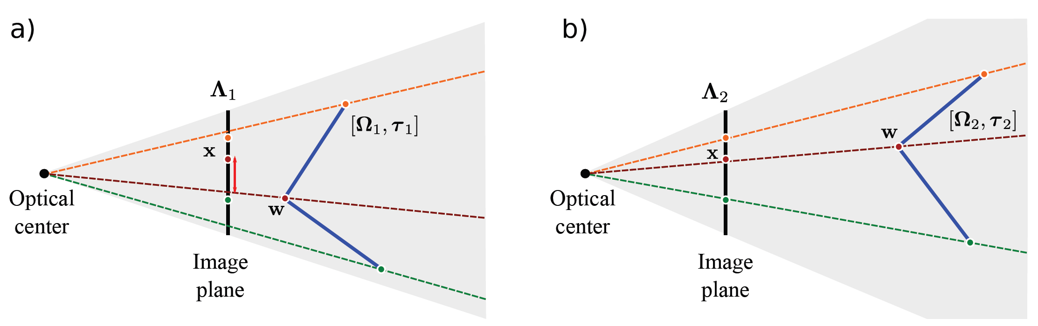
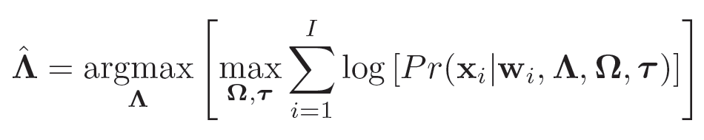

Problem 2 – Learning intrinsic parameters (calibration)
Use maximum likelihood:

Slide 18
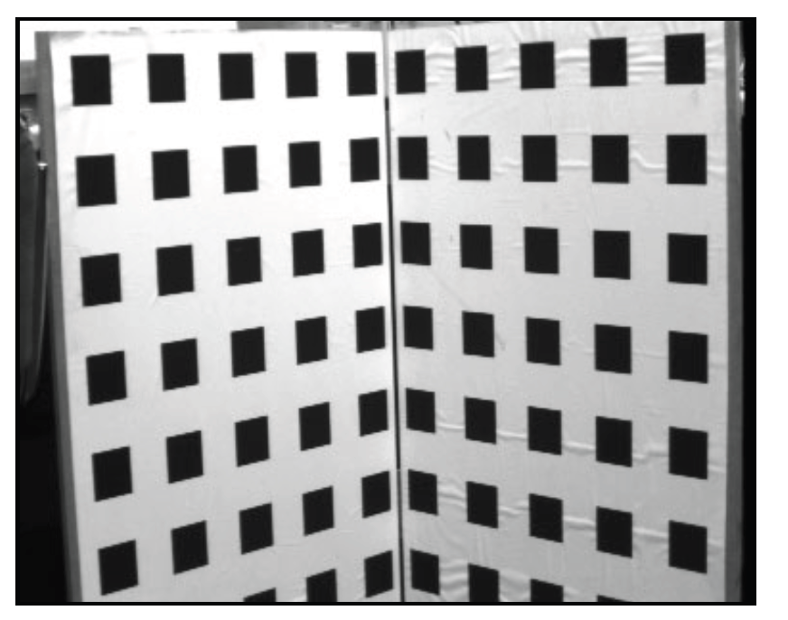
Calibration
Use 3D target with known 3D points

Slide 19
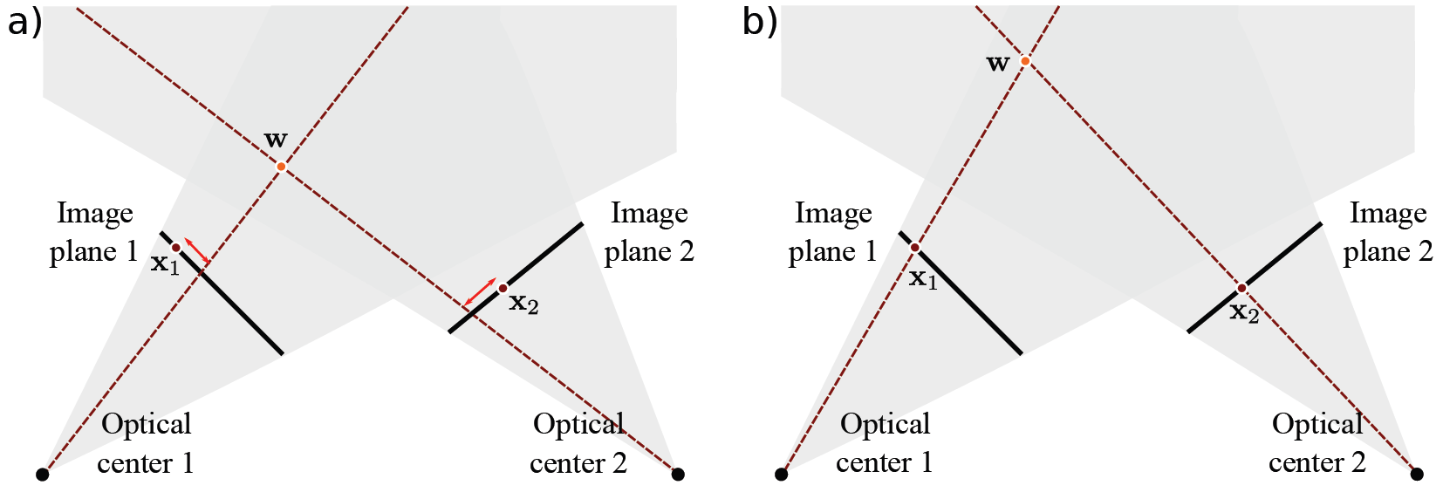
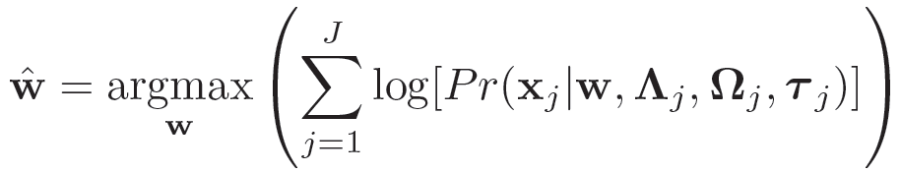
Problem 3 – Inferring 3D points (triangulation / reconstruction)
Use maximum likelihood:

Slide 20
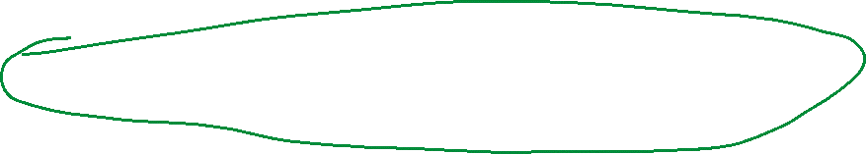
Solving the problems
None of these problems can be solved in closed form
Can apply non-linear optimization to find best solution but slow and prone to local minima
Solution – convert to a new representation (homogeneous coordinates) where we can solve in closed form.
Caution! We are not solving the true problem – finding global minimum of wrong* problem. But can use as starting point for non-linear optimization of true problem
*= We’ll first minimize algebraic error, instead of geometric error (see Minimizing Algebraic Error in Geometric Estimation Problems, Hartley 1998)

Slide 21
Structure
Pinhole camera model
Three geometric problems
Homogeneous coordinates
Solving the problems
Exterior orientation problem
Camera calibration
3D reconstruction
Applications
Computer vision: models, learning and inference. ©2011 Simon J.D. Prince
21

Slide 22
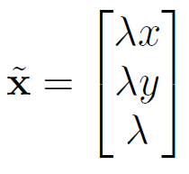
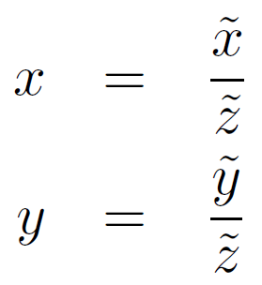
Homogeneous coordinates
Convert 2D coordinate to 3D
To convert back

Slide 23
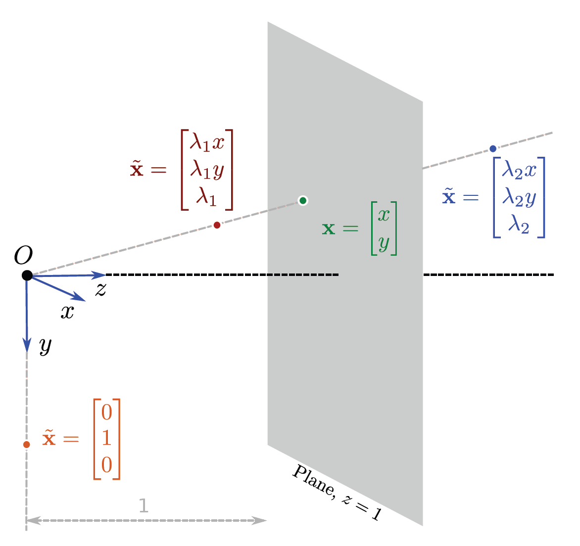
Geometric interpretation of homogeneous coordinates

Slide 24
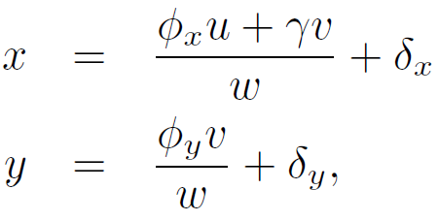
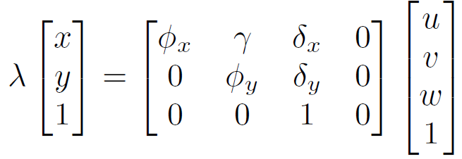
Pinhole camera in homogeneous coordinates
Camera model:
In homogeneous coordinates:
(linear!)

Slide 25
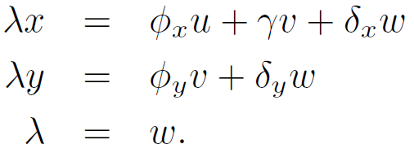
Pinhole camera in homogeneous coordinates
Writing out these three equations
Eliminate λ to retrieve original equations

Slide 26
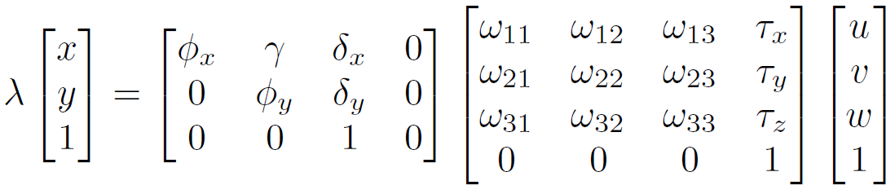
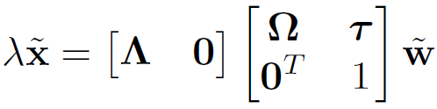
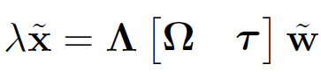

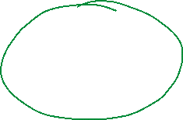




Adding in extrinsic parameters
Or for short:
Or even shorter:

Slide 27
Structure
Pinhole camera model
Three geometric problems
Homogeneous coordinates
Solving the problems
Exterior orientation problem
Camera calibration
3D reconstruction
Applications
Computer vision: models, learning and inference. ©2011 Simon J.D. Prince
27

Slide 28
Problem 1: Learning extrinsic parameters (exterior orientation)
Use maximum likelihood:

Slide 29
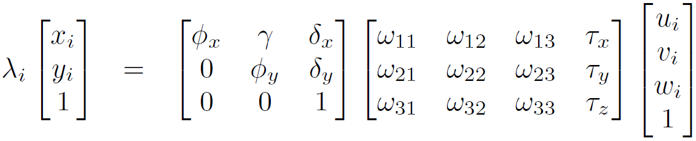
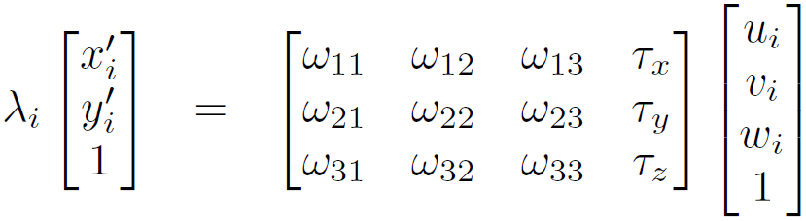



Exterior orientation
Start with camera equation in homogeneous coordinates
Pre-multiply both sides by inverse of camera calibration matrix
29

Slide 30
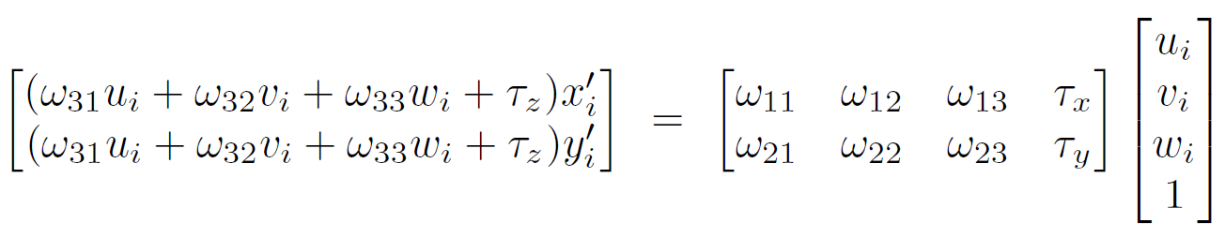
Exterior orientation
The third equation gives us an expression for λ
Substitute back into first two lines
30

Slide 31
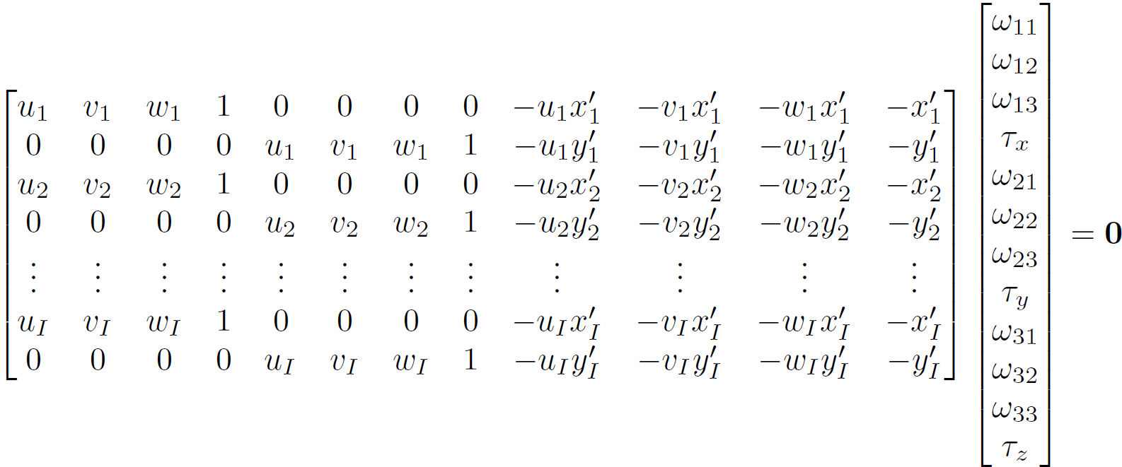
Exterior orientation
Linear equation – two equations per point – form system of equations
31

Slide 32
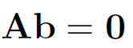
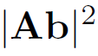
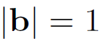
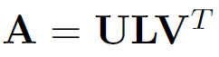
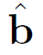
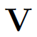

Exterior orientation
Minimum direction problem of the form , Find minimum of subject to .
To solve, compute the SVD and then set to the last column of .
32

Slide 33






Exterior orientation
Now we extract the values of and from .
Problem: the scale is arbitrary and the rows and columns of the rotation matrix may not be orthogonal.
Solution: compute SVD and then choose .
Use the ratio between the rotation matrix before and after to rescale
Use these estimates for start of non-linear optimisation.
33

Slide 34
Structure
Pinhole camera model
Three geometric problems
Homogeneous coordinates
Solving the problems
Exterior orientation problem
Camera calibration
3D reconstruction
Applications
Computer vision: models, learning and inference. ©2011 Simon J.D. Prince
34

Slide 35
Problem 2 – Learning intrinsic parameters (calibration)
Use maximum likelihood:

Slide 36


Calibration
One approach (not very efficient) is to alternately
Optimize extrinsic parameters for fixed intrinsic
Optimize intrinsic parameters for fixed extrinsic
( Then use non-linear optimization )

Slide 37

Intrinsic parameters
Maximum likelihood approach
This is a least squares problem.

Slide 38





Intrinsic parameters
The function is linear w.r.t. intrinsic parameters. Can be written in form
Now solve least squares problem

Slide 39
Structure
Pinhole camera model
Three geometric problems
Homogeneous coordinates
Solving the problems
Exterior orientation problem
Camera calibration
3D reconstruction
Applications
Computer vision: models, learning and inference. ©2011 Simon J.D. Prince
39

Slide 40
Problem 3 – Inferring 3D points (triangulation / reconstruction)
Use maximum likelihood:

Slide 41


Reconstruction
Write j^{th} pinhole camera in homogeneous coordinates:
Pre-multiply with inverse of intrinsic matrix

Slide 42


Reconstruction
Last equations gives
Substitute back into first two equations
Re-arranging get two linear equations for [u,v,w]
Solve using >1 cameras and then use non-linear optimization

Slide 43
Structure
Pinhole camera model
Three geometric problems
Homogeneous coordinates
Solving the problems
Exterior orientation problem
Camera calibration
3D reconstruction
Applications
Computer vision: models, learning and inference. ©2011 Simon J.D. Prince
43

Slide 44


Depth from structured light

Slide 45

Depth from structured light

Slide 46


Depth from structured light

Slide 47

Shape from silhouette

Slide 48


Shape from silhouette

Slide 49

Shape from silhouette

Slide 50
Conclusion
Pinhole camera model is a non-linear function that takes points in 3D world and finds where they map to in image
Parameterized by intrinsic and extrinsic matrices
Difficult to estimate intrinsic/extrinsic/depth because non-linear
Use homogeneous coordinates where we can get closed form solutions (initial sol’ns only)

